Slide 1
AUTOMATED NEONATAL EXCHANGE TRANSFUSION
ANET 4.0

Slide 2



Presentation By
AMEYAW ARTHUR SAMUEL.
BANDOMA GIDEON.
CANN JOSEPHINE.

Slide 3
Agenda
Background
History
Problem statement
Objectives

Slide 4
BACKGROUND:
Neonatal exchange transfusion is a medical technique used to replace the blood of a newborn with donor blood to treat jaundice.
Jaundice is a common neonatal disease that can cause lifelong brain damage, cerebral palsy, or hearing loss.
The most effective therapy for severe jaundice is exchange transfusion.
The process normally takes several hours and may need to be done numerous times until the levels are reduced to acceptable limits.

Slide 5
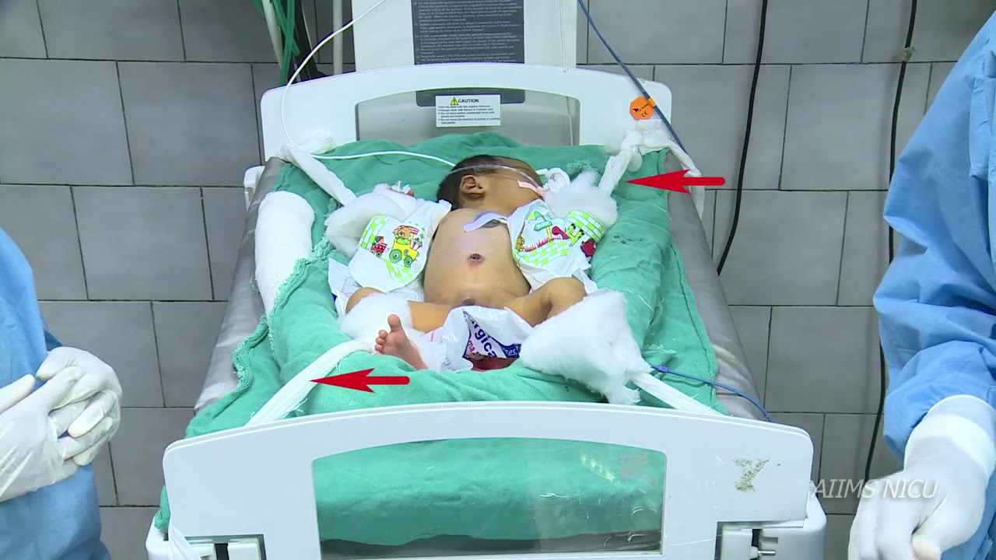
BACKGROUND:
Exchange transfusion has the potential to save lives, but it is not without risks, such as infection, blood clots, and vascular damage to the fetus. The baby's blood pressure may also decrease, so it is usually done in a hospital under medical supervision.

Slide 6
HISTORY:
The origins of neonatal exchange transfusion may be traced back to the early twentieth century when doctors initially investigated the use of blood transfusions as a therapy for newborn diseases. Dr. George Crile Jr. of the Cleveland Clinic performed the first successful neonatal exchange transfusion in 1911 to treat a newborn with severe hemolytic disease. The operation consisted of extracting the infant's blood and replacing it with donor blood, allowing the newborn to recover.

Slide 7
HISTORY: Neonatal Exchange Transfusion CONT’D
Neonatal exchange transfusion became a common treatment for severe jaundice in the 1940s and 1950s, helping to prevent brain damage and other complications associated with high levels of bilirubin in the blood.
Neonatal exchange transfusion was once a risky and complicated procedure, but advances in medical technology and new treatments such as phototherapy and intravenous immunoglobulin (IVIG) made it less common in the 1960s and 1970s.

Slide 8
PROBLEM STATEMENT
One major issue is the potential for complications during the procedure. Exchange transfusion is an invasive procedure that carries the risk of infection, bleeding, and damage to the baby's veins.
A miscalculation such as pumping the blood with too much force might explode the newborn's vein, killing the neonate instantaneously. It necessitates extreme accuracy and attention.

Slide 9
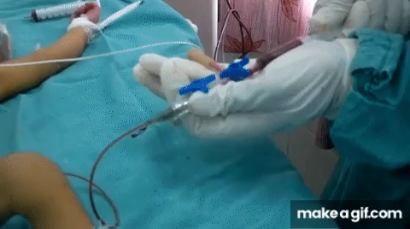
PROBLEM STATEMENT
Exchange transfusion is a life-saving procedure that involves slowly withdrawing and replacing a patient’s blood with fresh blood from a donor. It takes about two hours and is repeated a couple of times to prevent damage to internal organs. It is time-consuming and can lead to errors, making it unappealing.

Slide 10
OBJECTIVES: ANET 4.0
Model and Simulate the ANET machine using LabView Software
DEVELOP, AND BUILD A WORKING ANET MACHINE
CONDUCT AN AUTOMATED EXCHANGE TRANSFUSION ON LAB SUBJECTS
PRODUCE A COST-EFFECTIVE AND ENERGY SAVING WORKING ANET

Slide 11
Thank You!
AUTOMATED NEONATAL EXCHANGE TRANSFUSION

